Slide 1
Domain ML
Technology: Python
PHISHING WEBSITE DETECTION USING MACHINE LEARNING

Slide 2
ABSTRACT
Phishing is a common attack on credulous people by making them to disclose their unique information using counterfeit websites. The objective of phishing website URLs is to purloin the personal information like user name, passwords and online banking transactions. Phishers use the websites which are visually and semantically similar to those real websites. As technology continues to grow, phishing techniques started to progress rapidly and this needs to be prevented by using anti-phishing mechanisms to detect phishing. Machine learning is a powerful tool used to strive against phishing attacks. This paper surveys the features used for detection and detection techniques using machine learning.
Keywords: Decision Tree, Random forest, XGBoost , performance Anlysis.

Slide 3
INTRODUCTION
Phishing is the most unsafe criminal exercises in cyber space. Since most of the users go online to access the services provided by government and financial institutions, there has been a significant increase in phishing attacks for the past few years. Phishers started to earn money and they are doing this as a successful business. Various methods are used by phishers to attack the vulnerable users such as messaging, VOIP, spoofed link and counterfeit websites. It is very easy to create counterfeit websites, which looks like a genuine website in terms of layout and content. Even, the content of these websites would be identical to their legitimate websites. The reason for creating these websites is to get private data from users like account numbers, login id, passwords of debit and credit card, etc. Moreover, attackers ask security questions to answer to posing as a high level security measure providing to users. When users respond to those questions, they get easily trapped into phishing attacks. Many researches have been going on to prevent phishing attacks by different communities around the world. Phishing attacks can be prevented by detecting the websites and creating awareness to users to identify the phishing websites. Machine learning algorithms have been one of the powerful techniques in detecting phishing websites. In this study, various methods of detecting phishing websites have been discussed.

Slide 4
LITERATURE SURVEY
J. Shad and S. Sharma, “A Novel Machine Learning Approach to Detect Phishing Websites Jaypee Institute of Information Technology’’.
In the last few years, many fake websites have developed on the World Wide Web to harm users by stealing their confidential information such as account ID, user name, password, etc. Phishing is the social engineering attacks and currently attacks on mobile devices. That might result in the form of financial loses. In this paper, we described many detection techniques using URL, Hyperlinks features that can be used to differentiate between the defective and non-defective website. There are six main approaches such as heuristic, blacklist, Fuzzy Rule, machine learning, image processing, and CANTINA based approach. It delivers a good consideration of the phishing issue, a present machine learning solution, and future study about Phishing threats by using machine learning Approach.

Slide 5
2. Y. Sönmez, T. Tuncer, H. Gökal, and E. Avci, “Phishing web sites features classification based on extreme learning machine,” 6th Int. Symp. Digit. Forensic Secur. ISDFS - Proceeding.
Phishing is a common attack on credulous people by making them to disclose their unique information using counterfeit websites. The objective of phishing website URLs is to purloin the personal information like user name, passwords and online banking transactions. Phishers use the websites which are visually and semantically similar to those real websites. As technology continues to grow, phishing techniques started to progress rapidly and this needs to be prevented by using anti-phishing mechanisms to detect phishing. Machine learning is a powerful tool used to strive against phishing attacks. This paper surveys the features used for detection and detection techniques using machine learning.

Slide 6
3. T. Peng, I. Harris, and Y. Sawa, “Detecting Phishing Attacks Using Natural Language Processing and Machine Learning,” Proc. - 12th IEEE Int. Conf. Semant. Comput.
Phishing attacks are one of the most common and least defended security threats today. We present an approach which uses natural language processing techniques to analyse text and detect inappropriate statements which are indicative of phishing attacks. Our approach is novel compared to previous work because it focuses on the natural language text contained in the attack, performing semantic analysis of the text to detect malicious intent. To demonstrate the effectiveness of our approach, we have evaluated it using a large benchmark set of phishing emails.

Slide 7
4. M. Karabatak and T. Mustafa, “Performance comparison of classifiers on reduced phishing website dataset,” 6th Int. Symp. Digit. Forensic Secur. ISDFS - Proceeding.
These days, numerous enemy of phishing frameworks are being created to recognize phishing substance in online correspondence frameworks. In spite of the accessibility of hordes hostile to phishing frameworks, phishing proceeds with unabated because of lacking recognition of a zero-day assault, pointless computational overhead and high bogus rates. In spite of the fact that Machine Learning approaches have accomplished promising exactness rate, the decision and the exhibition of the component vector limit their successful location. Phishing is a typical assault on guileless individuals by making them to unveil their one of a kind data utilizing fake sites. In this work, an upgraded AI based prescient model is proposed to improve the effectiveness of against phishing plans. The prescient model comprises of Feature Selection Module which is utilized for the development of a successful element vector. These highlights are removed from the URL, website page properties and site page conduct utilizing the gradual segment-based framework to introduce the resultant component vector to the prescient model. The proposed framework utilizes CNN, KNN AND SVM which have been prepared on a 30-dimensional list of capabilities. AI is an incredible asset used to endeavor against phishing assaults

Slide 8
5. K. Shima et al., “Classification of URL bitstreams using bag of bytes,” in 21st Conference on Innovation in Clouds, Internet and Networks and Workshops (ICIN).
In present days ,websites are main responsible for the rapid growth of criminal activities in the internet and corresponding activities which results in the many illegal things. So there are many preventive steps to be taken to stop these kind of activities. Here we propose a model which will classify the given URL into any of the three possible classes ,.i.e. Benign, spam and malware. Our model will the detect the classification of the URL without using any websites content.

Slide 9
EXISTING SYSTEM
Where as in the case of the existing system means that what is previous system says a Manual human intervention is not that much applicable and error-prone. Legacy and Conventional Data Mining Algorithms can’t deal with huge volumes of data, slower and inaccurate.
Disadvantages:
Late process
Its more time
No accurate result

Slide 10
PROPOSED SYSTEM
Machine Learning is cutting edge and trending for different kinds of diverse application in the society where it can deal with tons of data, refined and revised algorithms, available heavy processing power in terms of GPU.
Advantages:
Fast process
Less time
Accurate result

Slide 11
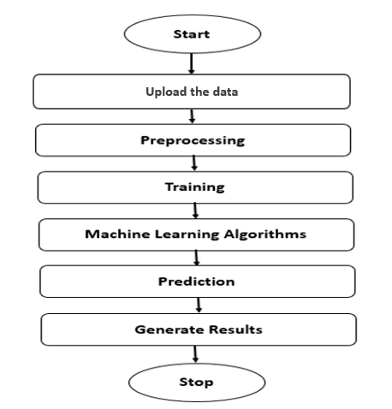
PROPOSED METHOD

Slide 12
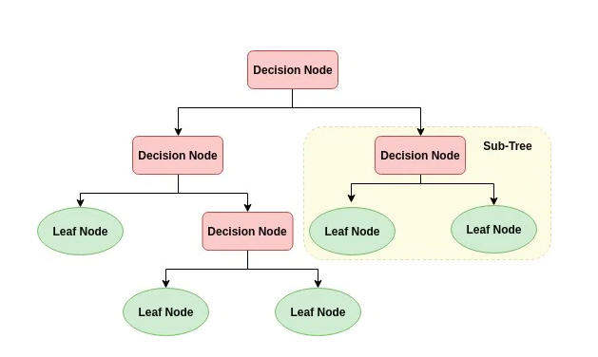
ALGORITHMS
Decision Tree:
Decision tree is a flowchart-like tree structure where an internal node represents feature(or attribute), the branch represents a decision rule, and each leaf node represents the outcome. The topmost node in a decision tree is known as the root node. It learns to partition on the basis of the attribute value. It partitions the tree in recursively manner call recursive partitioning. This flowchart-like structure helps you in decision making. It's visualization like a flowchart diagram which easily mimics the human level thinking. That is why decision trees are easy to understand and interpret.

Slide 13
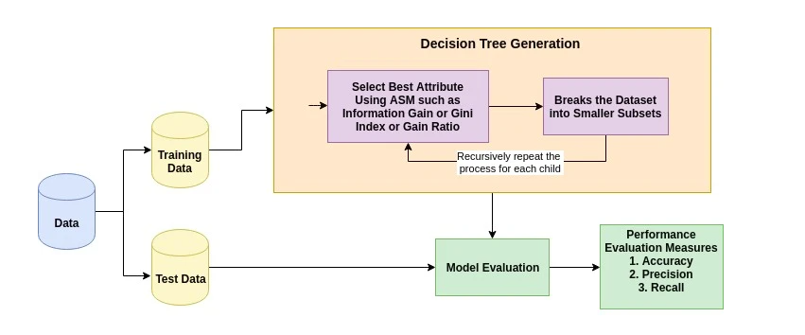
The basic idea behind any decision tree algorithm is as follows:
Select the best attribute using Attribute Selection Measures (ASM) to split the records.
Make that attribute a decision node and breaks the dataset into smaller subsets.
Starts tree building by repeating this process recursively for each child until one of the conditions will match:
All the tuples belong to the same attribute value.
There are no more remaining attributes.
There are no more instances.

Slide 14
2. XGBOOST:
XGBoost stands for “Extreme Gradient Boosting”. XGBoost is an optimized distributed gradient boosting library designed to be highly efficient, flexible and portable. It implements Machine Learning algorithms under the Gradient Boosting framework. It provides a parallel tree boosting to solve many data science problems in a fast and accurate way.
Boosting
Boosting is an ensemble learning technique to build a strong classifier from several weak classifiers in series. Boosting algorithms play a crucial role in dealing with bias-variance trade-off. Unlike bagging algorithms, which only controls for high variance in a model, boosting controls both the aspects (bias & variance) and is considered to be more effective XGBoost stands for eXtreme Gradient Boosting. It became popular in the recent days and is dominating applied machine learning and Kaggle competitions for structured data because of its scalability.

Slide 15
3. RANDOM FOREST CLASSIFIER:
A random forest is a machine learning technique that’s used to solve regression and classification problems. It utilizes ensemble learning, which is a technique that combines many classifiers to provide solutions to complex problems.
A random forest algorithm consists of many decision trees. The ‘forest’ generated by the random forest algorithm is trained through bagging or bootstrap aggregating. Bagging is an ensemble meta-algorithm that improves the accuracy of machine learning algorithms.
The (random forest) algorithm establishes the outcome based on the predictions of the decision trees. It predicts by taking the average or mean of the output from various trees. Increasing the number of trees increases the precision of the outcome.
A random forest eradicates the limitations of a decision tree algorithm. It reduces the over fitting of datasets and increases precision. It generates predictions without requiring many configurations in packages (like Scikit-learn).

Slide 16
Features of a Random Forest Algorithm:
It’s more accurate than the decision tree algorithm.
It provides an effective way of handling missing data.
It can produce a reasonable prediction without hyper-parameter tuning.
It solves the issue of over fitting in decision trees.
In every random forest tree, a subset of features is selected randomly at the node’s splitting point.
Decision trees are the building blocks of a random forest algorithm. A decision tree is a decision support technique that forms a tree-like structure. An overview of decision trees will help us understand how random forest algorithms work.
A decision tree consists of three components: decision nodes, leaf nodes, and a root node. A decision tree algorithm divides a training dataset into branches, which further segregate into other branches. This sequence continues until a leaf node is attained. The leaf node cannot be segregated further.
The nodes in the decision tree represent attributes that are used for predicting the outcome. Decision nodes provide a link to the leaves. The following diagram shows the three types of nodes in a decision tree.

Slide 17
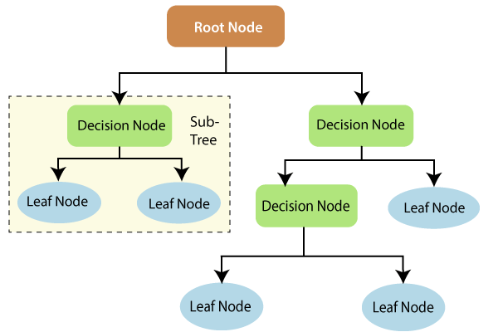
The information theory can provide more information on how decision trees work. Entropy and information gain are the building blocks of decision trees. An overview of these fundamental concepts will improve our understanding of how decision trees are built.
Entropy is a metric for calculating uncertainty. Information gain is a measure of how uncertainty in the target variable is reduced, given a set of independent variables.
The information gain concept involves using independent variables (features) to gain information about a target variable (class). The entropy of the target variable (Y) and the conditional entropy of Y (given X) are used to estimate the information gain. In this case, the conditional entropy is subtracted from the entropy of Y.

Slide 18
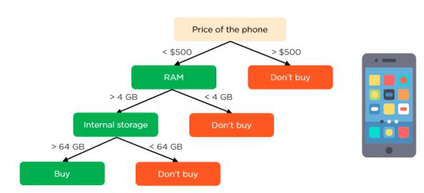
Information gain is used in the training of decision trees. It helps in reducing uncertainty in these trees. A high information gain means that a high degree of uncertainty (information entropy) has been removed. Entropy and information gain are important in splitting branches, which is an important activity in the construction of decision trees.
Let’s take a simple example of how a decision tree works. Suppose we want to predict if a customer will purchase a mobile phone or not. The features of the phone form the basis of his decision. This analysis can be presented in a decision tree diagram.
The root node and decision nodes of the decision represent the features of the phone mentioned above. The leaf node represents the final output, either buying or not buying. The main features

Slide 19
HARDWARE AND SOFTWARE REQUIREMENTS
H/W Configuration:
Operating system : Windows 7 or 7+
RAM : 8 GB
Hard disc or SSD : More than 500 GB
Processor : Intel 3rd generation or high or Ryzen with 8 GB Ram
S/W Configuration:
Software’s : Python 3.6 or high version
IDE : PyCharm.
Framework : Flask

Slide 20
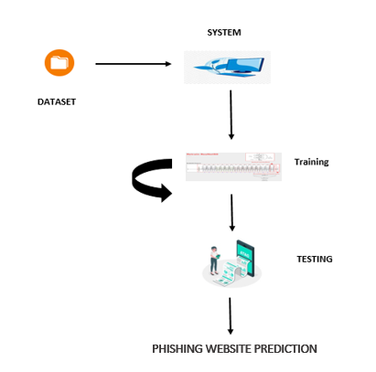
ARCHITECTURE:

Slide 21
UML DIAGRAMS
UML stands for Unified Modelling Language. UML is a standardized general-purpose modelling language in the field of object-oriented software engineering. The standard is managed, and was created by, the Object Management Group.
The goal is for UML to become a common language for creating models of object-oriented computer software. In its current form UML is comprised of two major components: a Meta-model and a notation. In the future, some form of method or process may also be added to; or associated with, UML.
The Unified Modelling Language is a standard language for specifying, Visualization, Constructing and documenting the artefacts of software system, as well as for business modelling and other non-software systems. The UML represents a collection of best engineering practices that have proven successful in the modelling of large and complex systems.
The UML is a very important part of developing objects-oriented software and the software development process. The UML uses mostly graphical notations to express the design of software projects.

Slide 22
GOALS:
The Primary goals in the design of the UML are as follows:
Provide users a ready-to-use, expressive visual modelling Language so that they can develop and exchange meaningful models.
Provide extendibility and specialization mechanisms to extend the core concepts.
Be independent of particular programming languages and development process.
Provide a formal basis for understanding the modelling language.
Encourage the growth of OO tools market.
Support higher level development concepts such as collaborations, frameworks, patterns and components.
Integrate best practices.

Slide 23
USE CASE DIAGRAM
A use case diagram in the Unified Modeling Language (UML) is a type of behavioral diagram defined by and created from a Use-case analysis.
Its purpose is to present a graphical overview of the functionality provided by a system in terms of actors, their goals (represented as use cases), and any dependencies between those use cases.
The main purpose of a use case diagram is to show what system functions are performed for which actor. Roles of the actors in the system can be depicted.

Slide 24
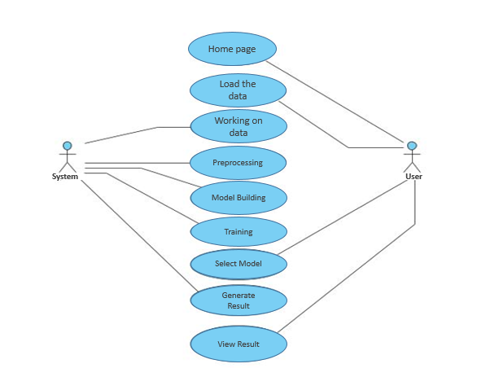

Slide 25
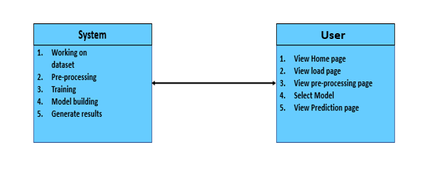
CLASS DIAGRAM
In software engineering, a class diagram in the Unified Modeling Language (UML) is a type of static structure diagram that describes the structure of a system by showing the system's classes, their attributes, operations (or methods), and the relationships among the classes. It explains which class contains information

Slide 26
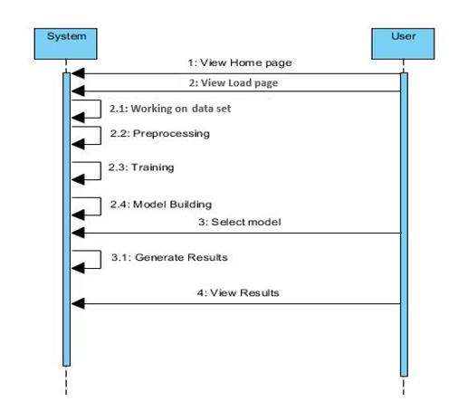
SEQUENCE DIAGRAM
A sequence diagram in Unified Modeling Language (UML) is a kind of interaction diagram that shows how processes operate with one another and in what order.
It is a construct of a Message Sequence Chart. Sequence diagrams are sometimes called event diagrams, event scenarios, and timing diagrams

Slide 27
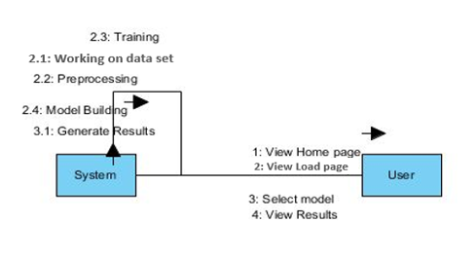
COLLABORATION DIAGRAM:
In collaboration diagram the method call sequence is indicated by some numbering technique as shown below. The number indicates how the methods are called one after another. We have taken the same order management system to describe the collaboration diagram. The method calls are similar to that of a sequence diagram. But the difference is that the sequence diagram does not describe the object organization whereas the collaboration diagram shows the object organization.

Slide 28
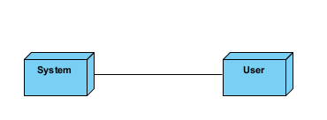
DEPLOYMENT DIAGRAM
Deployment diagram represents the deployment view of a system. It is related to the component diagram. Because the components are deployed using the deployment diagrams. A deployment diagram consists of nodes. Nodes are nothing but physical hardware’s used to deploy the application.

Slide 29
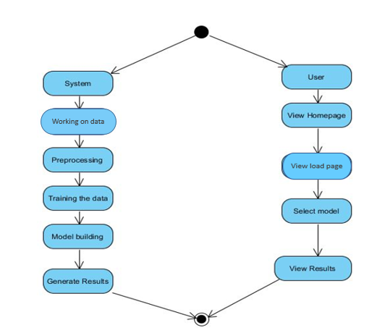
ACTIVITY DIAGRAM:
Activity diagrams are graphical representations of workflows of stepwise activities and actions with support for choice, iteration and concurrency. In the Unified Modelling Language, activity diagrams can be used to describe the business and operational step-by-step workflows of components in a system. An activity diagram shows the overall flow of control.

Slide 30
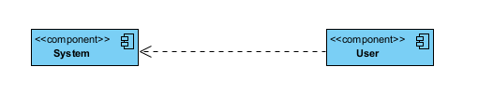
COMPONENT DIAGRAM:
A component diagram, also known as a UML component diagram, describes the organization and wiring of the physical components in a system. Component diagrams are often drawn to help model implementation details and double-check that every aspect of the system's required function is covered by planned development.

Slide 31
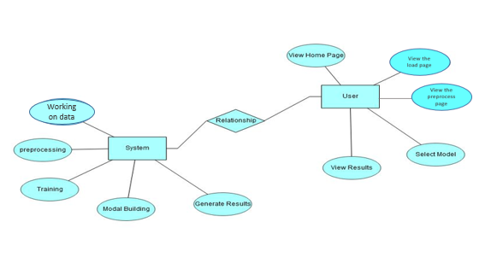
ER DIAGRAM:
An Entity–relationship model (ER model) describes the structure of a database with the help of a diagram, which is known as Entity Relationship Diagram (ER Diagram). An ER model is a design or blueprint of a database that can later be implemented as a database. The main components of E-R model are: entity set and relationship set.
An ER diagram shows the relationship among entity sets. An entity set is a group of similar entities and these entities can have attributes. In terms of DBMS, an entity is a table or attribute of a table in database, so by showing relationship among tables and their attributes, ER diagram shows the complete logical structure of a database. Let’s have a look at a simple ER diagram to understand this concept.

Slide 32
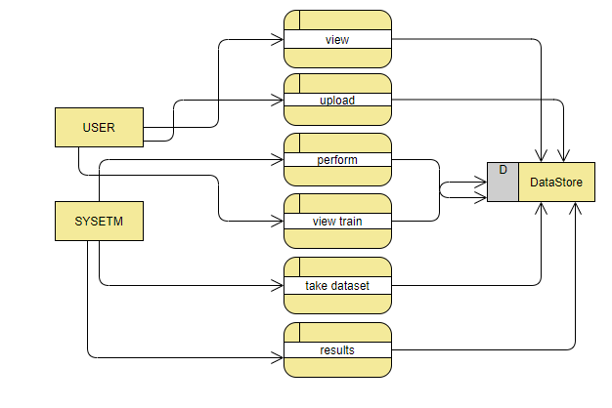
DFD DIAGRAM:
A Data Flow Diagram (DFD) is a traditional way to visualize the information flows within a system. A neat and clear DFD can depict a good amount of the system requirements graphically. It can be manual, automated, or a combination of both. It shows how information enters and leaves the system, what changes the information and where information is stored. The purpose of a DFD is to show the scope and boundaries of a system as a whole. It may be used as a communications tool between a systems analyst and any person who plays a part in the system that acts as the starting point for redesigning a system.

Slide 33
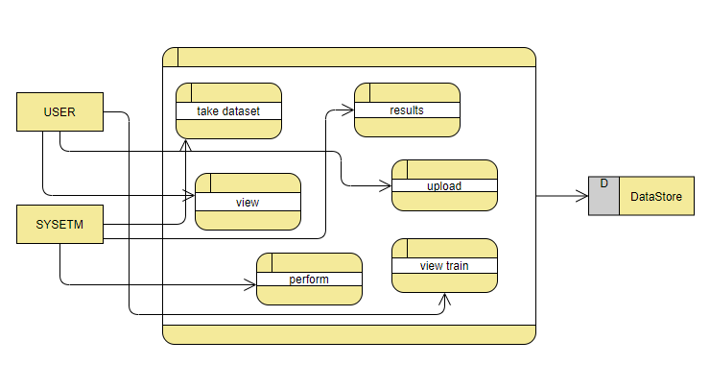

Slide 34

OUTPUT SCREEN SHOTS WITH DESCRIPTION.
Home Page:
Here user view the home page of phishing website prediction web application.

Slide 35

Load:
In the load page, users can load the website dataset.

Slide 36
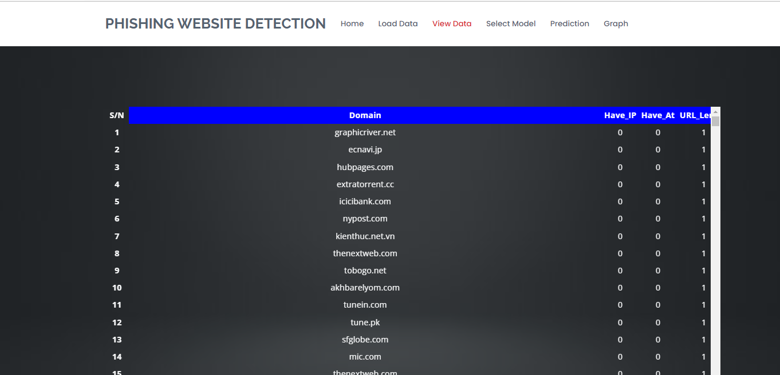
View:
Here we can see the uploaded data set.

Slide 37
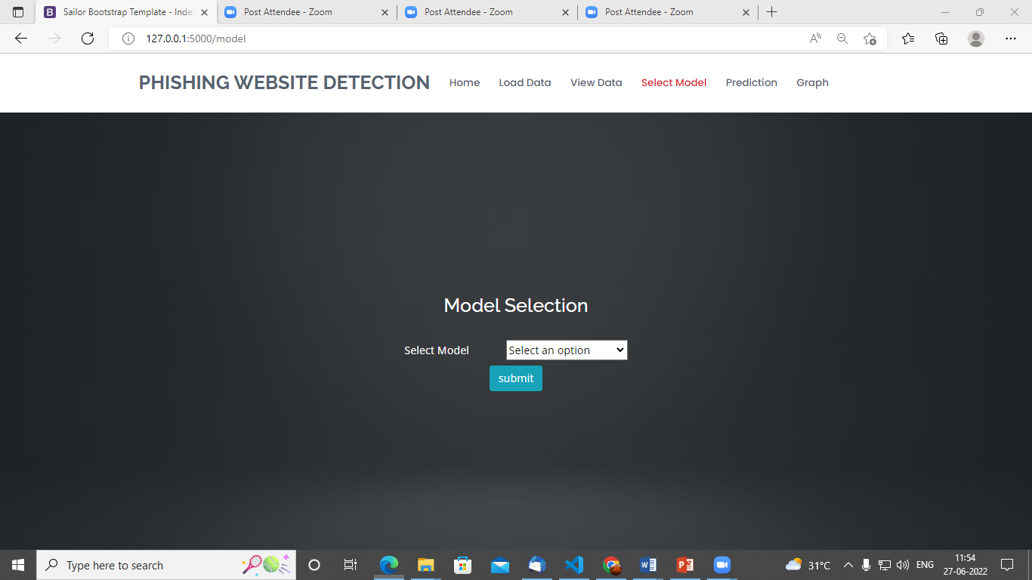
Model:
Here we can train our data using different algorithm.

Slide 38
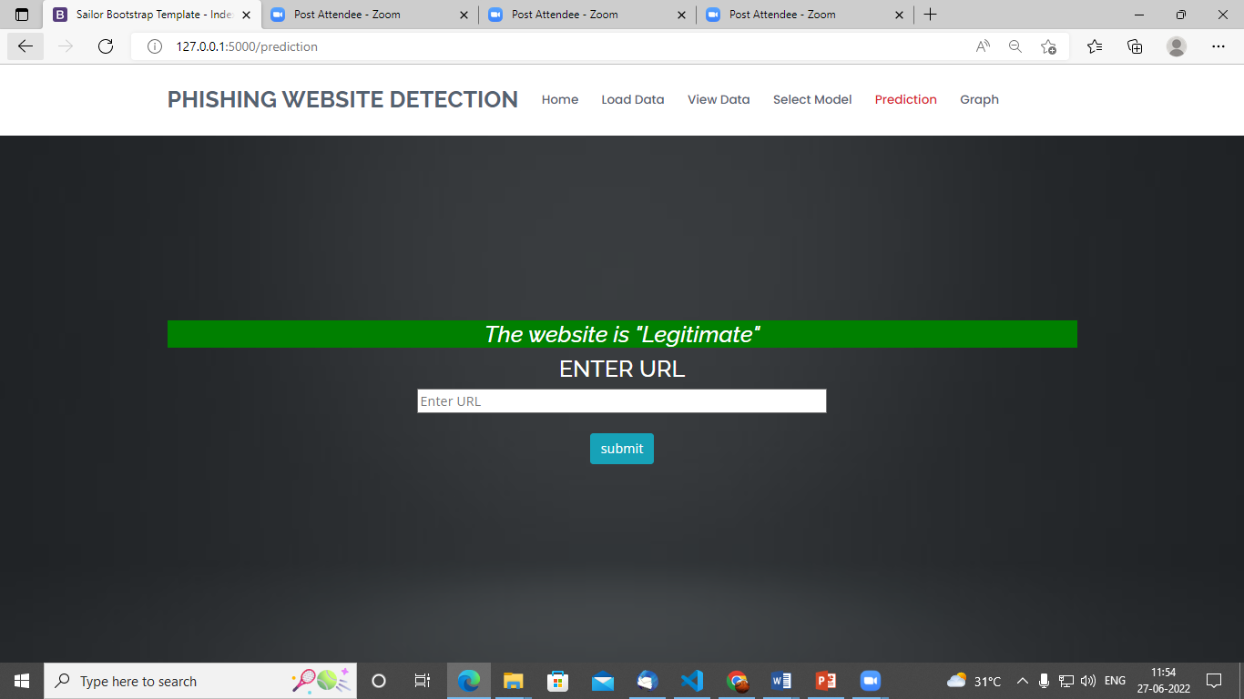
Prediction:
This page show the detection result that whether the website is a phishing website or legitimate.

Slide 39
CONCLUSION:
This survey presented various algorithms and approaches to detect phishing websites by several researchers in Machine Learning. On reviewing the papers, we came to a conclusion that most of the work done by using familiar machine learning algorithms like XGBoost, Decision Tree and Random Forest and MLP classifier which generates the neural network results. Some authors proposed a new system like Phish Score and Phish Checker for detection. The combinations of features with regards to accuracy, precision, recall etc. were used. As phishing websites increases day by day, some features may be included or replaced with new ones to detect them.
FUTURE SCOPE
There are quite a few things that can be polished or be added in the future work. • We have opted to use two data mining classifies in this project namely the ID3 and Naive Bayes classifier. There are more classieres such as the Bayesian network classifier, Neural Network classifier and C4.5 classifier. Such classifiers were not included in this paper and could be counted in future to give a more data to be compared with.

Slide 40
REFERENCES:
1. J. Shad and S. Sharma, “A Novel Machine Learning Approach to Detect Phishing Websites Jaypee Institute of Information Technology,” pp. 425–430, 2018.
2. Y. Sönmez, T. Tuncer, H. Gökal, and E. Avci, “Phishing web sites features classification based on extreme learning machine,” 6th Int. Symp. Digit. Forensic Secur. ISDFS 2018 - Proceeding, vol. 2018–Janua, pp. 1–5, 2018.
3. T. Peng, I. Harris, and Y. Sawa, “Detecting Phishing Attacks Using Natural Language Processing and Machine Learning,” Proc. - 12th IEEE Int. Conf. Semant. Comput. ICSC 2018, vol. 2018–Janua, pp. 300–301, 2018.
4. M. Karabatak and T. Mustafa, “Performance comparison of classifiers on reduced phishing website dataset,” 6th Int. Symp. Digit. Forensic Secur. ISDFS 2018 - Proceeding, vol. 2018–Janua, pp. 1–5, 2018.
5. S. Parekh, D. Parikh, S. Kotak, and P. S. Sankhe, “A New Method for Detection of Phishing Websites: URL Detection,” in 2018 Second International Conference on Inventive Communication and Computational Technologies (ICICCT), 2018, vol. 0, no. Icicct, pp. 949–952.

Slide 41
6. K. Shima et al., “Classification of URL bitstreams using bag of bytes,” in 2018 21st Conference on Innovation in Clouds, Internet and Networks and Workshops (ICIN), 2018, vol. 91, pp. 1–5.
7. A. Vazhayil, R. Vinayakumar, and K. Soman, “Comparative Study of the Detection of Malicious URLs Using Shallow and Deep Networks,” in 2018 9th International Conference on Computing, Communication and Networking Technologies, ICCCNT 2018, 2018, pp. 1– 6.
8. W. Fadheel, M. Abusharkh, and I. Abdel-Qader, “On Feature Selection for the Prediction of Phishing Websites,” 2017 IEEE 15th Intl Conf Dependable, Auton. Secur. Comput. 15th Intl Conf Pervasive Intell. Comput. 3rd Intl Conf Big Data Intell. Comput. Cyber Sci. Technol. Congr., pp. 871–876, 2017.
9. X. Zhang, Y. Zeng, X. Jin, Z. Yan, and G. Geng, “Boosting the Phishing Detection Performance by Semantic Analysis,” 2017.
10. L. MacHado and J. Gadge, “Phishing Sites Detection Based on C4.5 Decision Tree Algorithm,” in 2017 International Conference on Computing, Communication, Control and Automation, ICCUBEA 2017, 2018, pp. 1–5.

Slide 42


